Slide 1
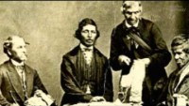
American Indian Cultural Contributions

